Slide 1
Comprehensive sales and profit dashboard
Tool Used: Power BI
Dataset Source: Sample Superstore Dataset

Slide 2
Purpose of the Dashboard
• Provide stakeholders with a clear view of key metrics (Sales, Profit, and Growth).
• Highlight regional performance and category-wise profitability.
• Enable informed decision-making through interactive elements.

Slide 3
Key Performance Indicators (KPIs)
• Total Sales: Summarizes all sales revenue.
• Total Profit: Revenue after subtracting costs.
• Growth Rate: Percentage increase compared to the previous period.

Slide 4
Sales Performance by Region
• Displays sales distribution across different geographical regions.
• Highlights top-performing regions and those needing improvement.

Slide 5
Product-Wise Profit Analysis
• Compares profit margins across various product categories.
• Identifies areas for potential cost optimization or increased focus.

Slide 6
Sales and Profit Trends Over Time
• Tracks sales and profit performance month-over-month or year-over-year.
• Reveals patterns for seasonal or cyclical sales.

Slide 7
Enhancing Insights Through Interactivity
• Filters and Slicers: Narrow down data by region, category, or time.
• Drill-Through Options: View detailed insights for specific data points.

Slide 8
Key Business Insights
• Regions contributing the most to overall sales.
• Categories with the highest profit margins.
• Suggestions for improving performance in underperforming segments.

Slide 9
Summary and Next Steps
• Summarize key findings from the dashboard.
• Recommend next steps for stakeholders based on the analysis.

Slide 10
Questions and Feedback
• Open the floor for questions.
• Encourage feedback to improve future dashboards.

Slide 11
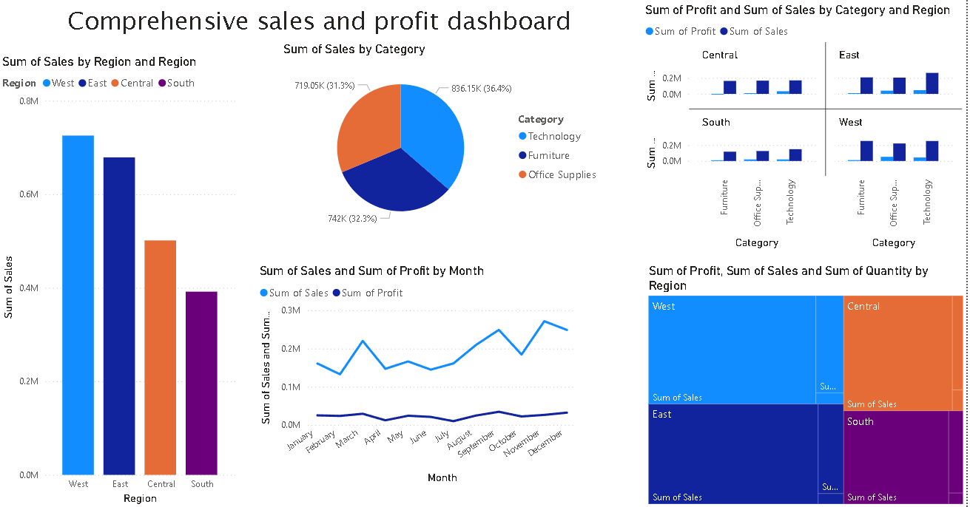
Comprehensive Sales and Profit Dashboard

